Slide 1
Chapter 03
What do interest rates mean and what is their role in valuation
(Why Yield to maturity is the most accurate measure of interest rate)
Notes:
If this PowerPoint presentation contains mathematical equations, you may need to check that your computer has the following installed:
1) MathType Plugin
2) Math Player (free versions available)
3) NVDA Reader (free versions available)

Slide 2
Learning Objectives
Calculate the present value of future cash flows and the yield to maturity on the four types of credit market instruments.
Recognize the distinctions among yield to maturity, current yield, rate of return, and rate of capital gain.
Interpret the distinction between real and nominal interest rates.

Slide 3
Measuring Interest Rates
Present value: a dollar paid to you one year from now is less valuable than a dollar paid to you today.
  Why: a dollar deposited today can earn interest and become $1×(1+i) one year from today.
  To understand the importance of this notion, consider the value of a $20 million lottery payout today versus a payment of $1 million per year for each of the next 20 years. Are these two values the same?

Slide 4
Present Value
Let i = .10
In one year: $100 × (1 + 0.10) = $110
In two years: $110 × (1 + 0.10) = $121
or $100 × (1 + 0.10)²
In three years: $121 × (1 + 0.10) = $133
or $100 × (1 + 0.10)³
In n years
$100 × (1 + i)^{n}

Slide 5
Simple Present Value (1 of 2)
PV = today’s (present) value
CF = future cash flow (payment)
i = the interest rate

Slide 6
Simple Present Value (2 of 2)
Cannot directly compare payments scheduled in different points in the time line

Slide 7
Four Types of Credit Market Instruments
Simple Loan
Fixed Payment Loan
Coupon Bond
Discount Bond

Slide 8
Yield to Maturity
Yield to maturity: the interest rate that equates the present value of cash flow payments received from a debt instrument with its value today

Slide 9
Yield to Maturity on a Simple Loan

Slide 10
Fixed-Payment Loan
The same cash flow payment every period throughout the life of the loan
LV = loan value
FP = fixed yearly payment
n = number of years until maturity

Slide 11
Coupon Bond (1 of 6)
Using the same strategy used for the fixed-payment loan:
P = price of coupon bond
C = yearly coupon payment
F = face value of the bond
n = years to maturity date

Slide 12
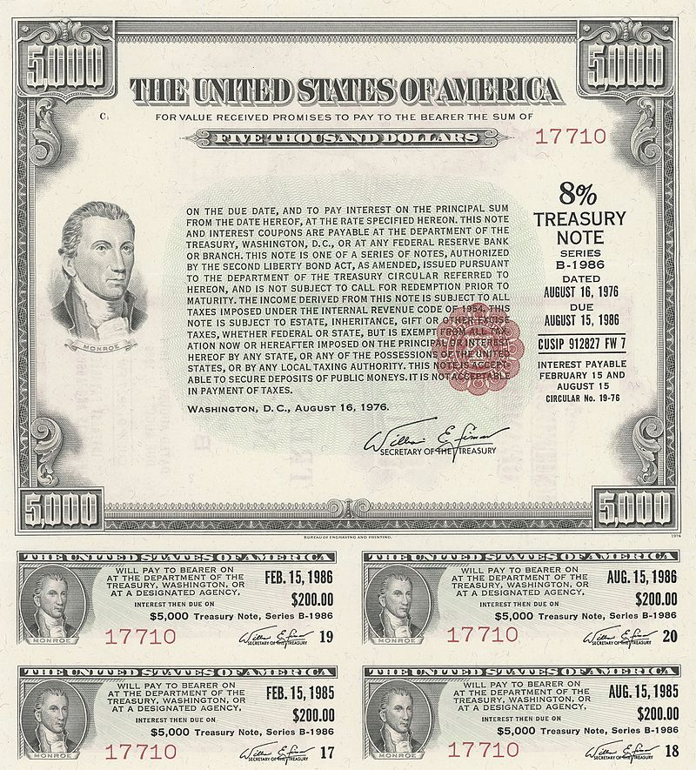
Coupon Bond (2 of 6)
A coupon bond is identified by four pieces of information:
Face value
Agencies that issue this bond
Maturity date
The coupon rate
Source: https://en.wikipedia.org/wiki/United_States_Treasury_security

Slide 13
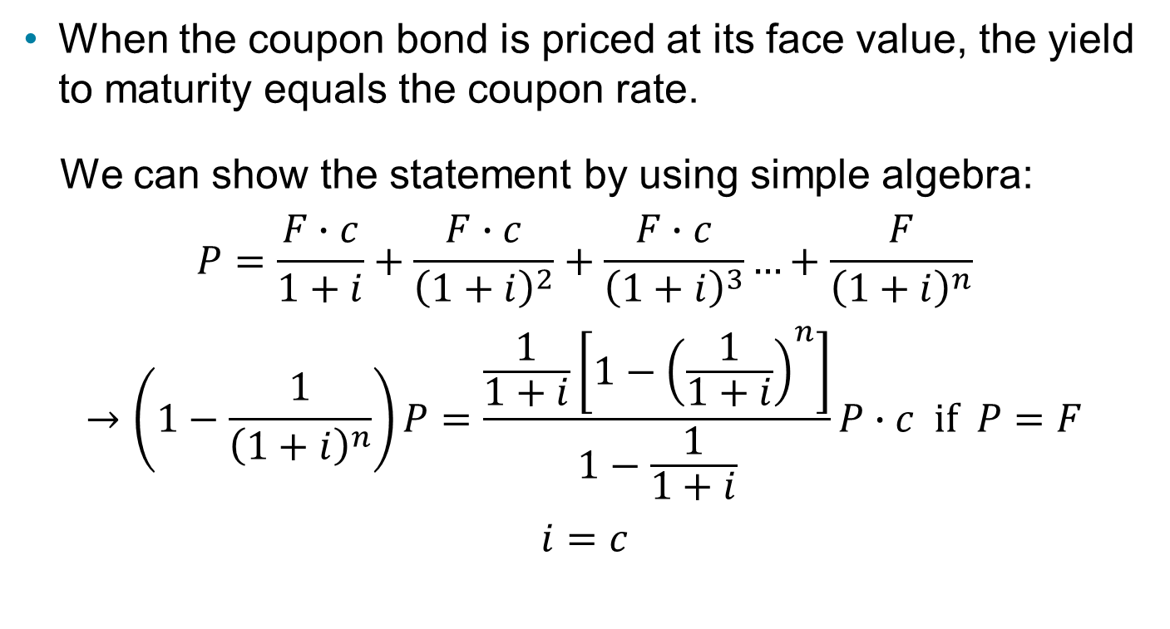
Coupon Bond (3 of 6)
When the coupon bond is priced at its face value, the yield to maturity equals the coupon rate.
We can show the statement by using simple algebra:
$$P=\frac{F∙c}{1+i}+\frac{F∙c}{{\left(1+i\right)}^{2}}+\frac{F∙c}{{\left(1+i\right)}^{3}}…+\frac{F}{{\left(1+i\right)}^{n}}$$
$$→\left(1−\frac{1}{{\left(1+i\right)}^{n}}\right)P=\frac{\frac{1}{1+i}\left[1−{\left(\frac{1}{1+i}\right)}^{n}\right]}{1−\frac{1}{1+i}}P∙c if P=F$$
$$i=c$$

Slide 14
Coupon Bond (4 of 6)
The price of a coupon bond and the yield to maturity are negatively related.
The yield to maturity is greater than the coupon rate when the bond price is below its face value.

Slide 15
Coupon Bond (5 of 6)
Table 1 Yields to Maturity on a 10%-Coupon-Rate Bond Maturing in Ten Years (Face Value = $1,000)
Price of Bond ($) | Yield to Maturity (%)
1,200 | 7.13
1,100 | 8.48
1,000 | 10.00
900 | 11.75
800 | 13.81

Slide 16
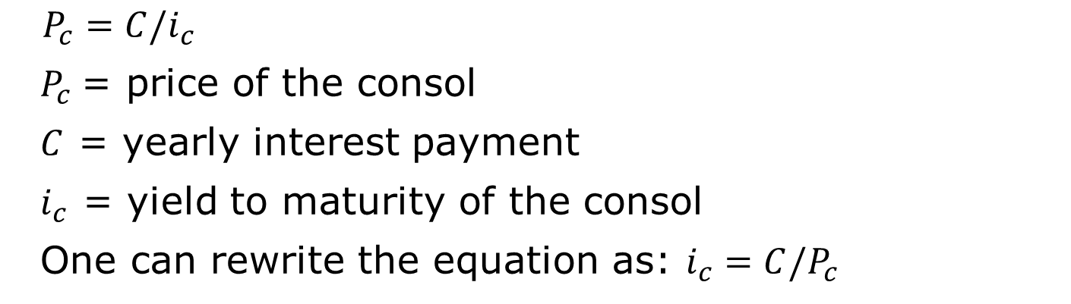
Coupon Bond (6 of 6)
Consol or perpetuity: a bond with no maturity date that does not repay principal but pays fixed coupon payments forever
For coupon bonds, this equation gives the current yield, an easy to calculate approximation to the yield to maturity
$P_{c}=C/i_{c}$
$P_{c}$= price of the consol
$C$ = yearly interest payment
$i_{c}$ = yield to maturity of the consol
One can rewrite the equation as: $i_{c}=C/P_{c}$

Slide 17
Discount Bond
For any one year discount bond
F = Face value of the discount bond
P = Current price of the discount bond
The yield to maturity equals the increase in price over the year divided by the initial price.
As with a coupon bond, the yield to maturity is negatively related to the current bond price.

Slide 18
The Distinction Between Interest Rates and Returns (1 of 4)
Rate of Return:

Slide 19
The Distinction Between Interest Rates and Returns (2 of 4)
The return equals the yield to maturity only if the holding period equals the time to maturity.
A rise in interest rates is associated with a fall in bond prices, resulting in a capital loss if time to maturity is longer than the holding period.
The more distant a bond’s maturity, the greater the size of the percentage price change associated with an interest-rate change.
Interest rates do not always have to be positive as evidenced by recent experience in Japan and several European states.

Slide 20
The Distinction Between Interest Rates and Returns (3 of 4)
The more distant a bond’s maturity, the lower the rate of return the occurs as a result of an increase in the interest rate.
Even if a bond has a substantial initial interest rate, its return can be negative if interest rates rise.

Slide 21
The Distinction Between Interest Rates and Returns (4 of 4)
Table 2 One-Year Returns on Different-Maturity 10%-Coupon-Rate Bonds When Interest Rates Rise from 10% to 20%
(1) Years to Maturity When Bond Is Purchased | (2) Initial Current Yield (%) | (3) Initial Price ($) | (4) Price Next Year* ($) | (5) Rate of Capital Gain (%) | (6) Rate of Return [col (2) + col (5)] (%)
30 | 10 | 1,000 | 503 | −49.7 | −39.7
20 | 10 | 1,000 | 516 | −48.4 | −38.4
10 | 10 | 1,000 | 597 | −40.3 | −30.3
5 | 10 | 1,000 | 741 | −25.9 | −15.9
2 | 10 | 1,000 | 917 | −8.3 | +1.7
1 | 10 | 1,000 | 1,000 | 0.0 | +10.0
*Calculated with a financial calculator, using Equation 3.

Slide 22
Maturity and the Volatility of Bond Returns: Interest-Rate Risk
Prices and returns for long-term bonds are more volatile than those for shorter-term bonds.
There is no interest-rate risk for any bond whose time to maturity matches the holding period.

Slide 23
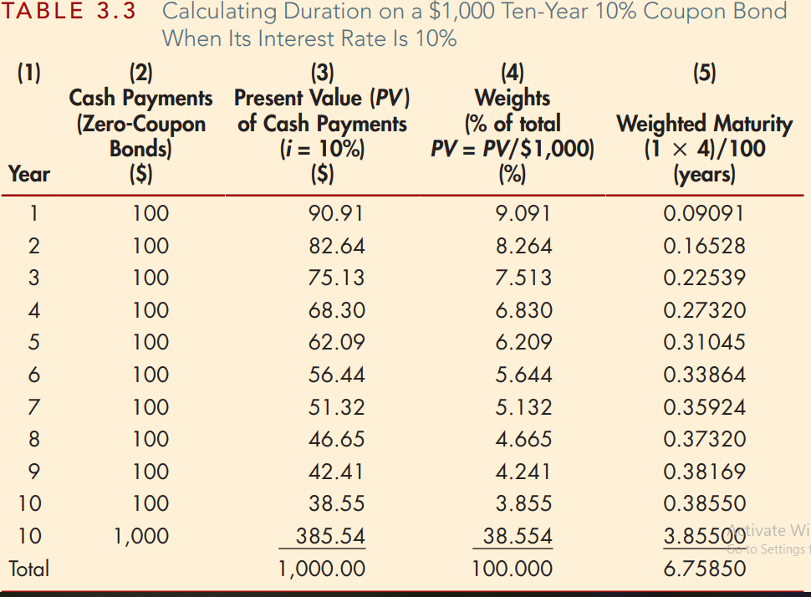
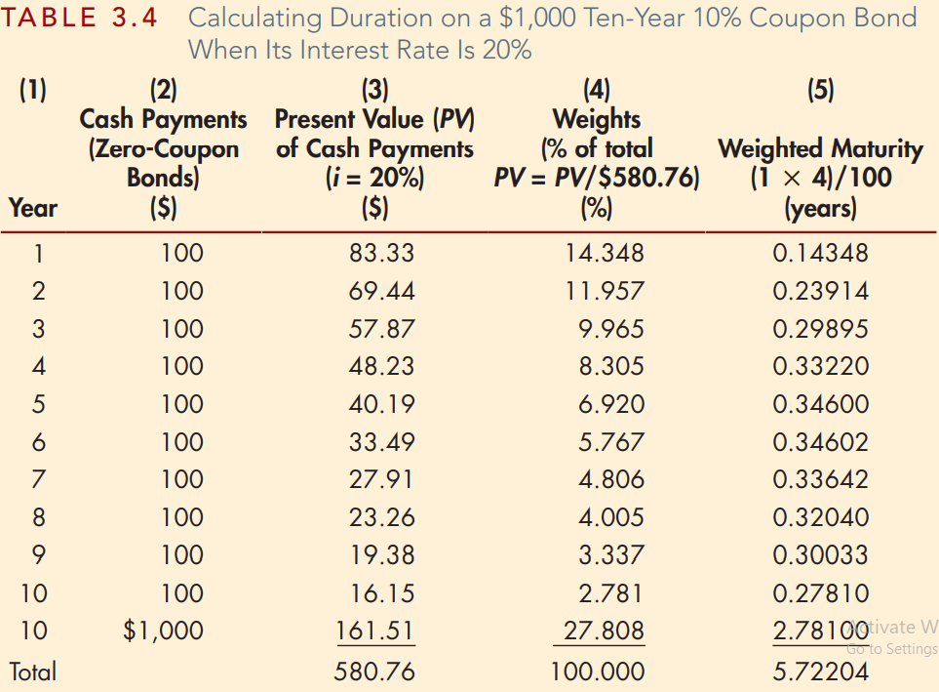
Calculating Duration (duration is a weighted average of the maturities of the cash payments)

Slide 24
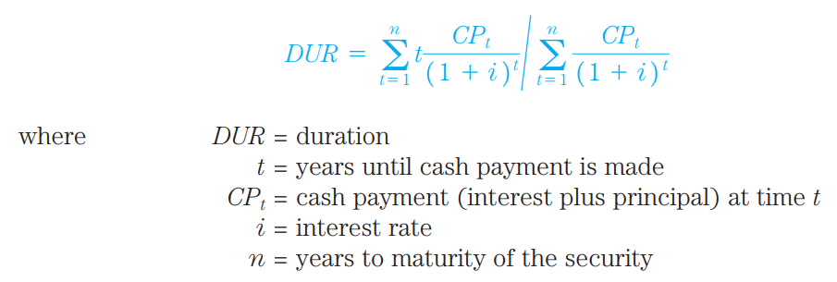
The duration calculation done in Table 3.3 and 3.4 can be written as follows
NOTE:
All else being equal, the longer the term to maturity of a bond, the longer its duration.
All else being equal, when interest rates rise, the duration of a coupon bond falls.
All else being equal, the higher the coupon rate on the bond, the shorter the bond’s duration.

Slide 25
Duration of a portfolio of the two securities is just the weighted average of the durations of the two securities, with the weights reflecting the proportion of the portfolio invested in each.
Example:
A manager of a financial institution is holding 25% of a portfolio in a bond with a five-year duration and 75% in a bond with a 10-year duration.
What is the duration of the portfolio?
Solution: The duration of the portfolio is 8.75 years.
(0.25 x 5) + (0.75 x 10) = 1.25 + 7.5 = 8.75 years

Slide 26
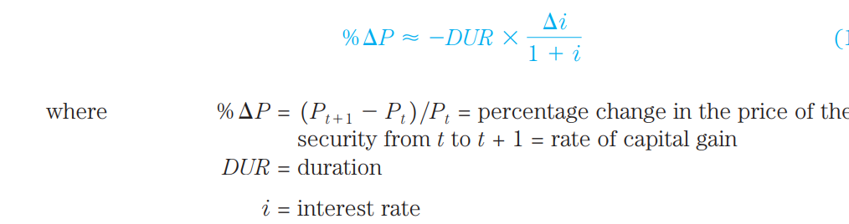
Duration and Interest-Rate Risk
Duration is a good approximation, particularly when interest-rate changes are small, for how much the security price changes for a given change in interest rates.

Slide 27
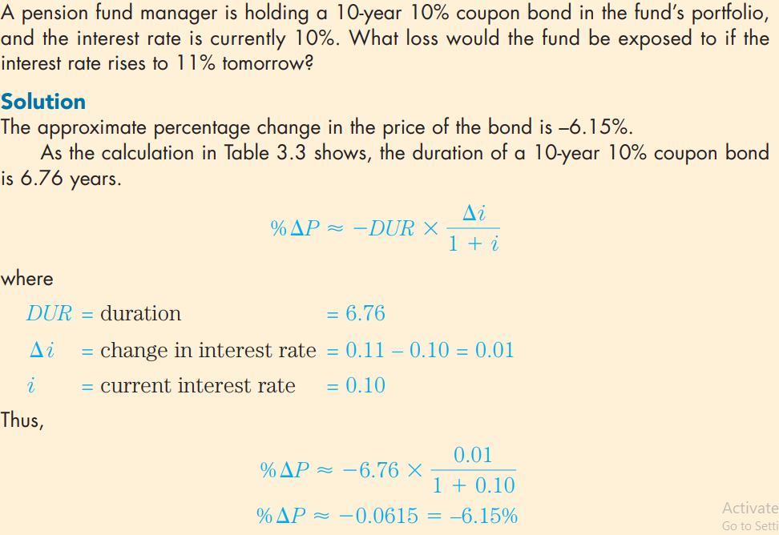
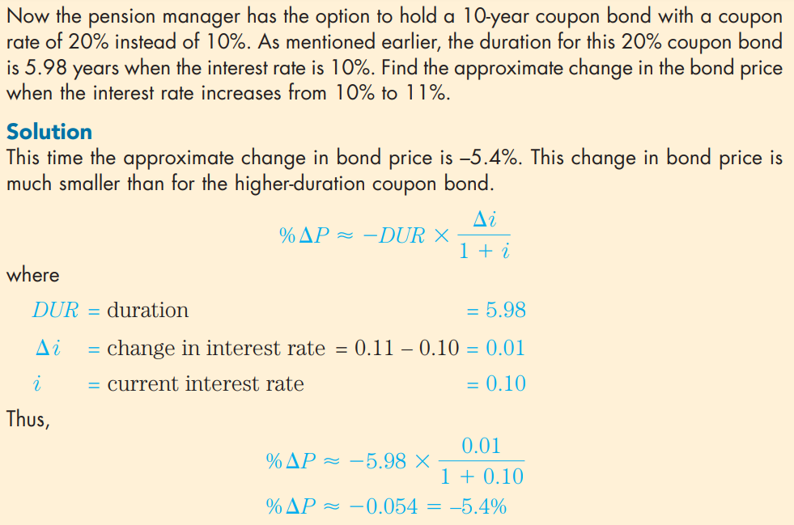

Slide 28
The Distinction Between Real and Nominal Interest Rates
Nominal interest rate makes no allowance for inflation.
Real interest rate is adjusted for changes in price level so it more accurately reflects the cost of borrowing.
  Ex ante real interest rate is adjusted for expected changes in the price level
  Ex post real interest rate is adjusted for actual changes in the price level

Slide 29
Fisher Equation

